Slide 1
IOT Cloud
By
Ashiwni Kulkarni

Slide 2

Project Description
Sent an alert msg to system if a car exceed its speed limit.
In alert following information Should be include:
Car Plate No
Speed Limit
Actual Speed

Slide 3
Steps:
Setup IBM Bluemix Device
Data Streaming to IBM Bluemix Device
Accessing Data From IBM Bluemix Device to Node Red
Data Visualization Using IBM Bluemix Board

Slide 4
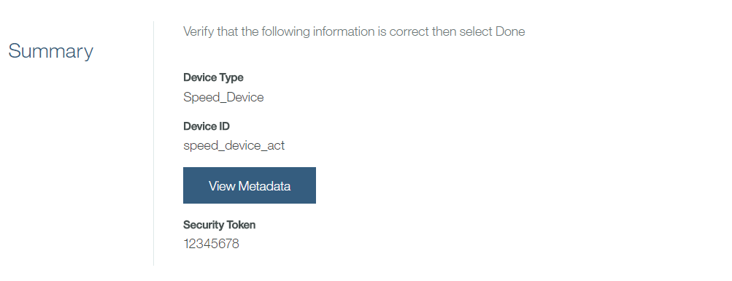
Setup IBM Blumix Device
Create Device Type
Create Device with Device Type
Generate API key and Store

Slide 5
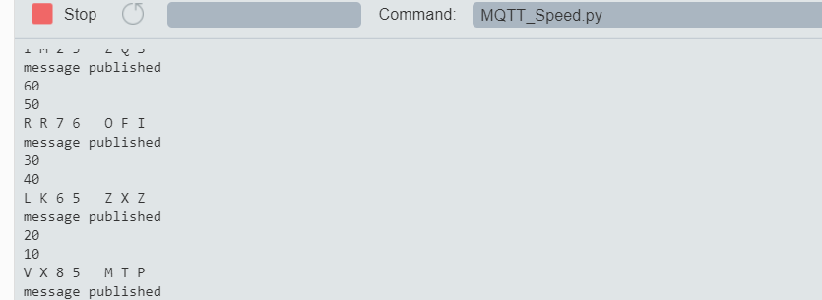
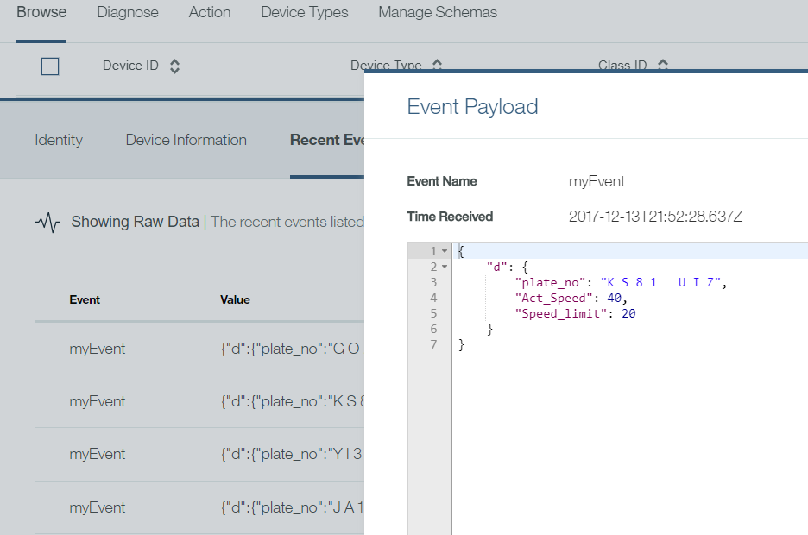
Data Streaming to IBM Bluemix Device
Writing Python Program using MQTT library
Send Streaming Data to device is created

Slide 6
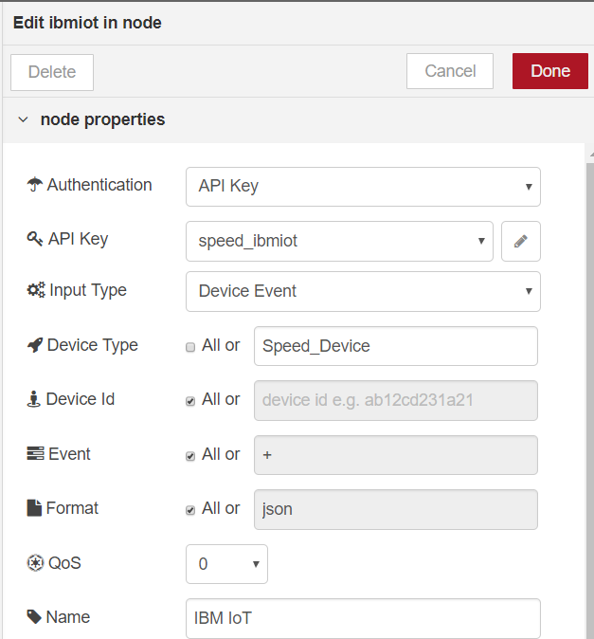
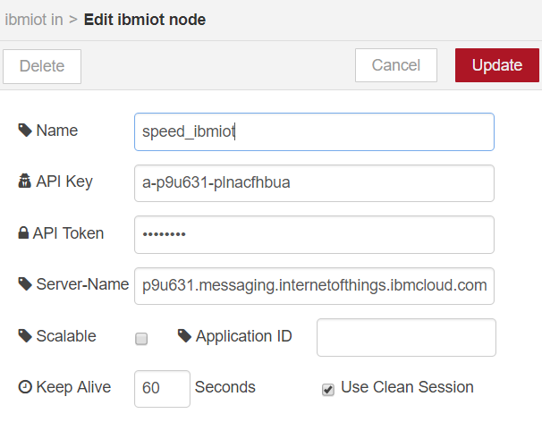
Accessing Data From IBM Blumix Device to NodeRed
Using IBM Iot Node=>

Slide 7
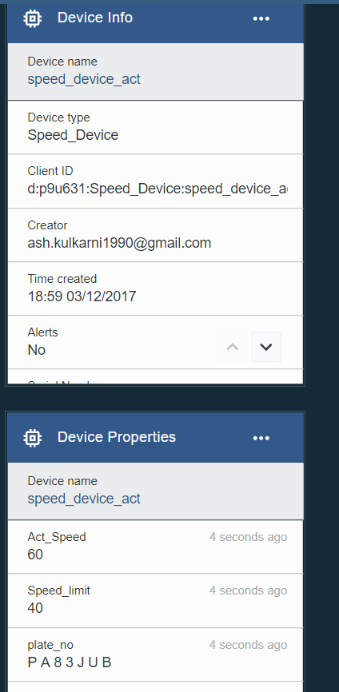
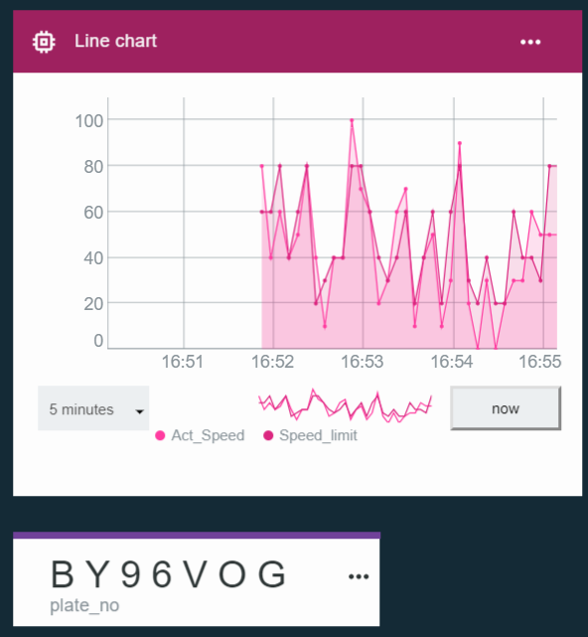
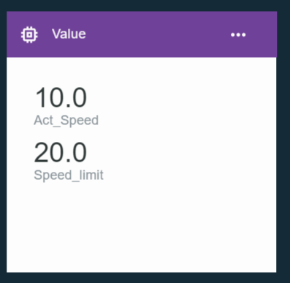
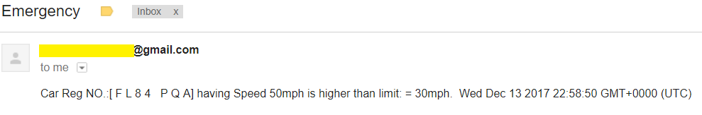
Data Visualization & Alerts Using IBM Bluemix Board

Slide 8
Thanks! Questions?

